Slide 1
Cache
Module - 16

Slide 2
Contents
Introduction to the Type System
Collections & Relations
Deployment

Slide 3
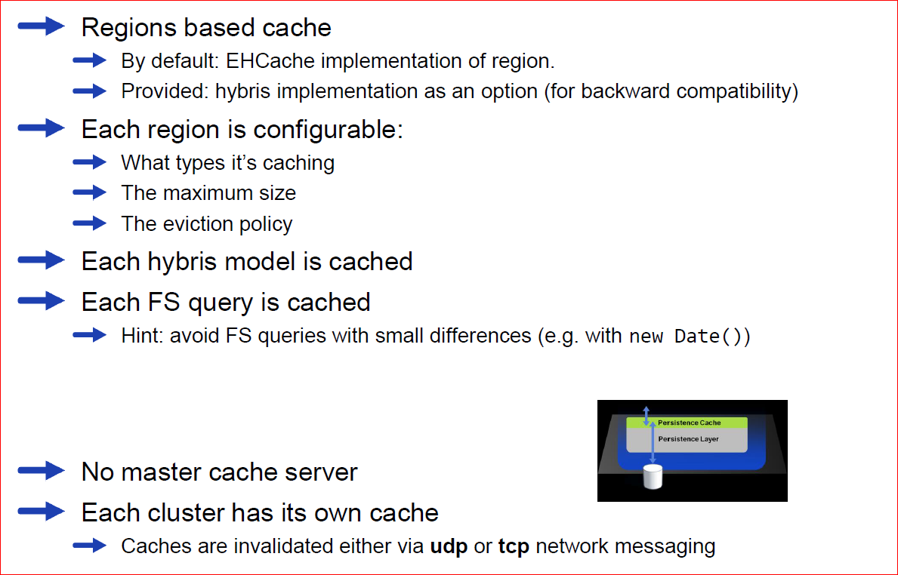
Theory

Slide 4
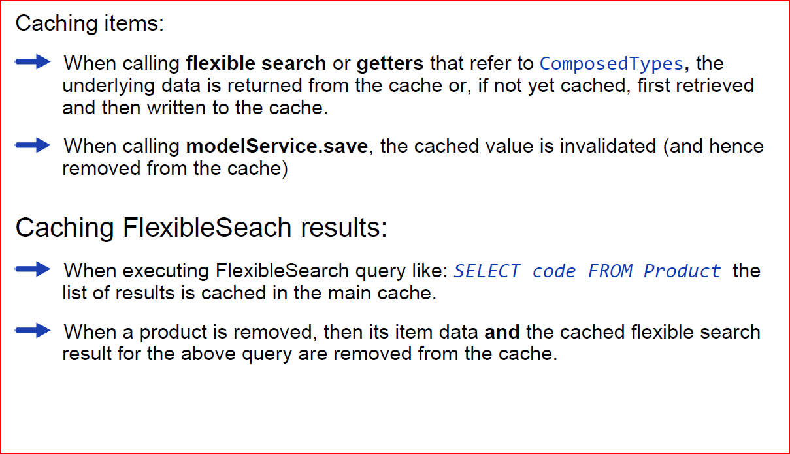
When Data Is Cached (and invalidated)

Slide 5
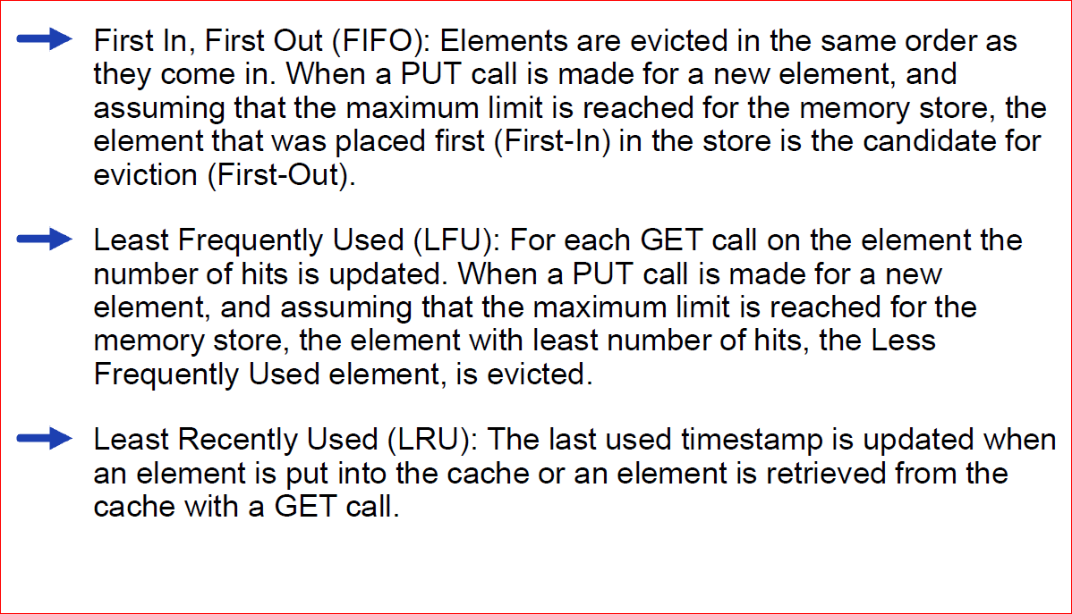
Eviction policies

Slide 6
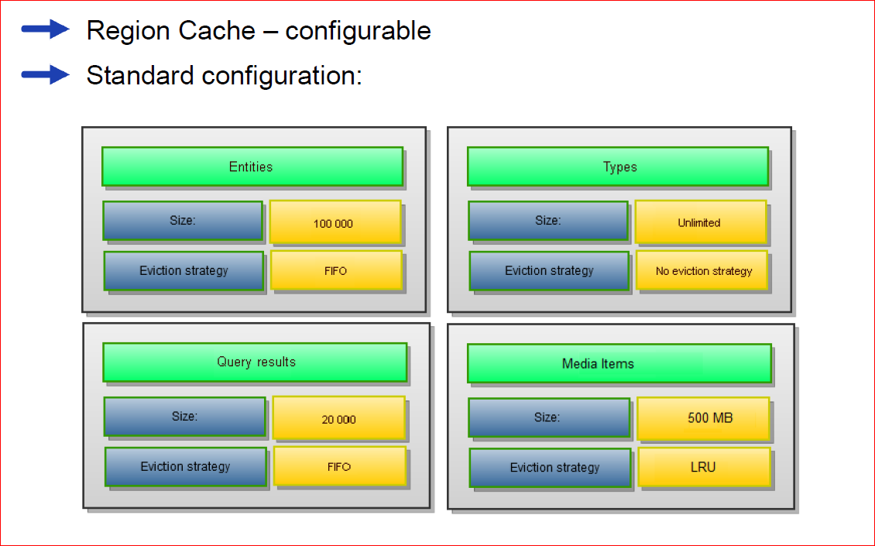
How Data Is Cached

Slide 7
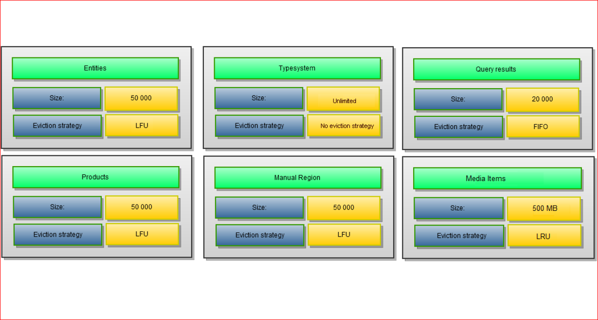
Example of custom cache configuration

Slide 8
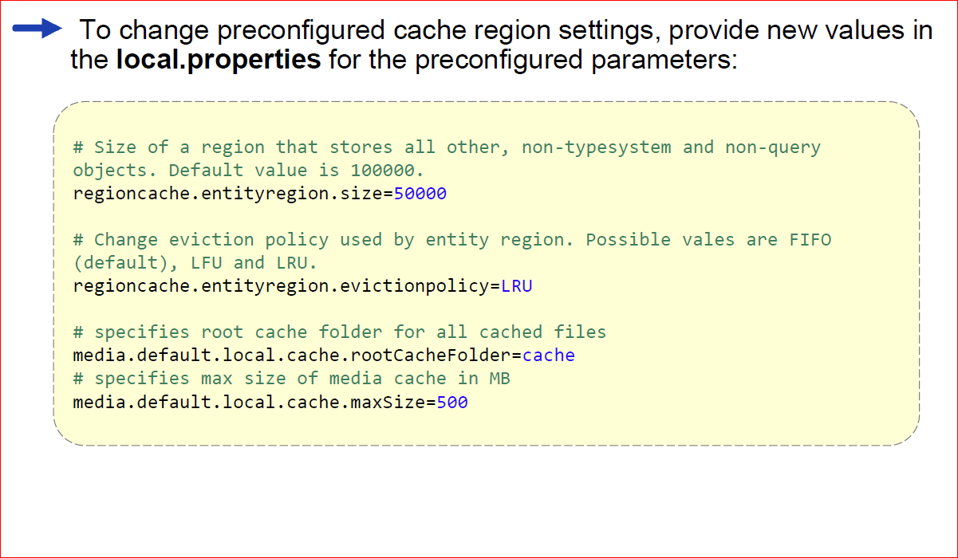
Custom cache configuration

Slide 9
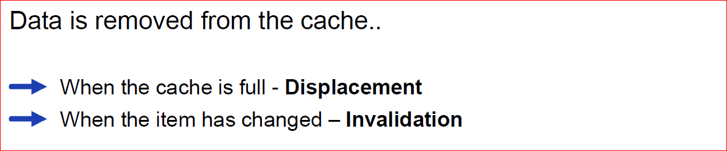
Cache - cleanup

